Slide 1
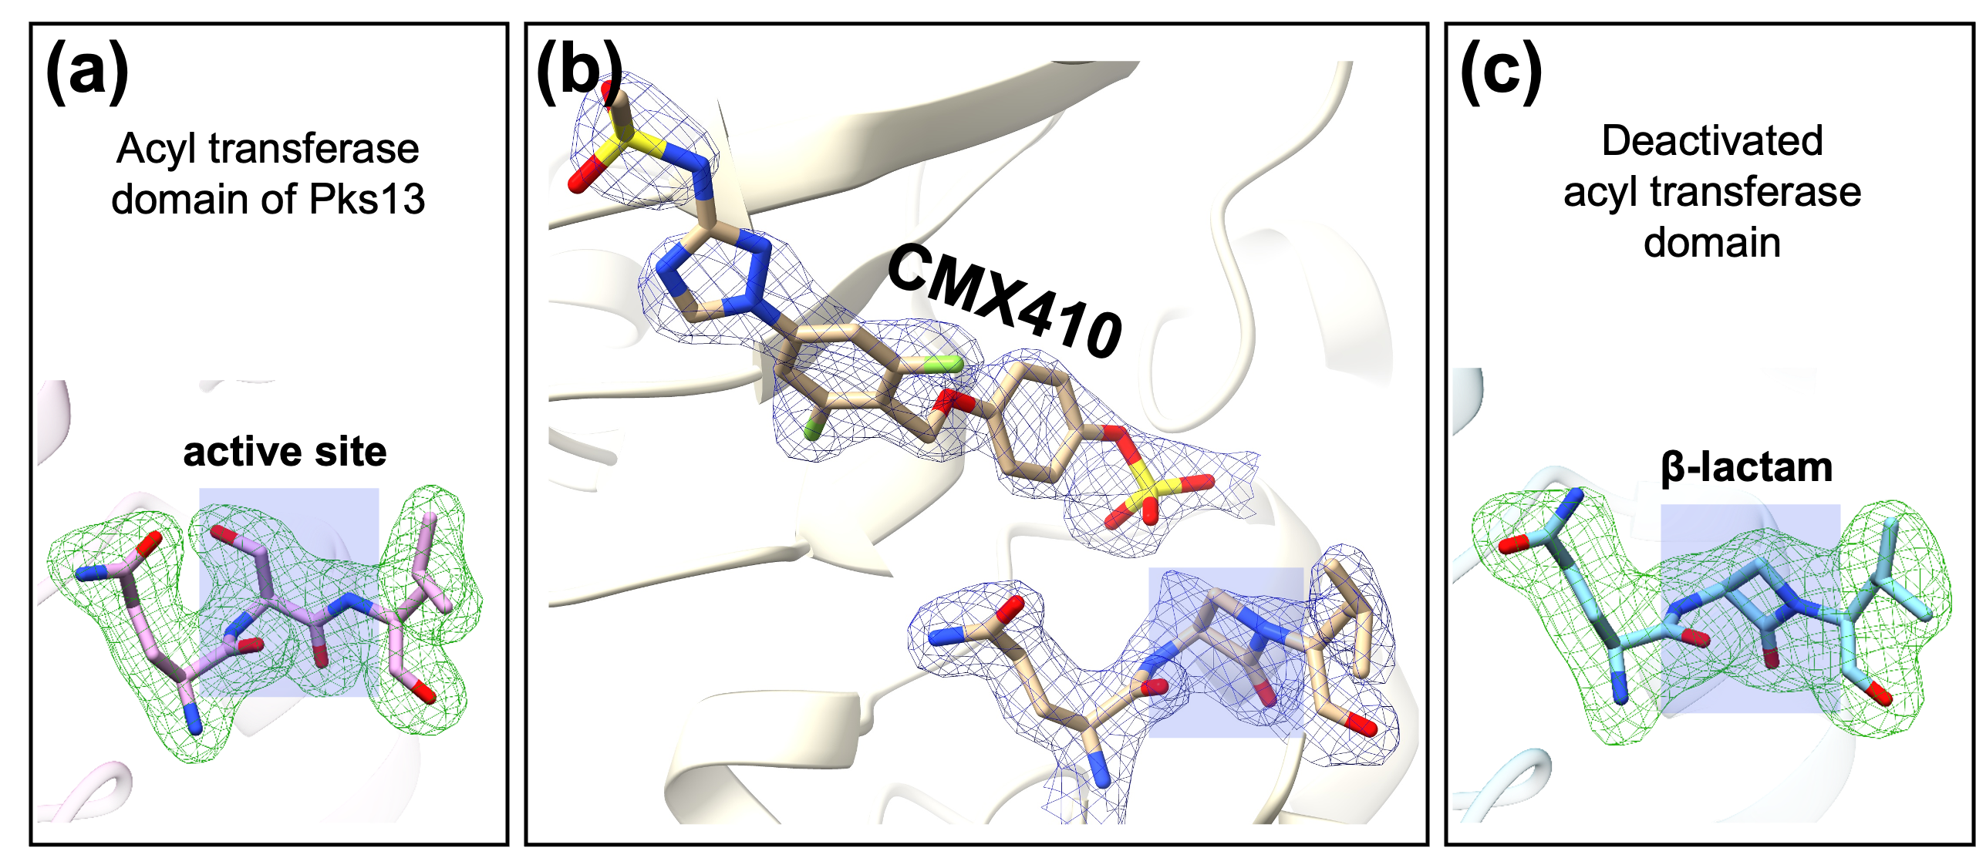















X-Rays Shed Light on Possible New Treatments for TB
Scientific Achievement
X-ray diffraction data revealed the crystal structure of CMX410, a new compound that targets a key enzyme (Pks13) in the cell membrane of the bacterium responsible for tuberculosis (TB).
Significance and Impact
CMX410 is a promising new candidate to treat TB, including multidrug-resistant strains.
Research Details
Protein crystallography data from the Advanced Light Source, Advanced Photon Source, and National Synchrotron Light Source-II revealed the interaction between CMX410 and Pks13 that permanently disables the bacterial enzyme.
To capture the reaction steps, the team sampled many conditions to ‘trap’ the intermediates as the inhibitor engaged with the enzyme.
Protein crystallography revealed the reaction steps between compound CMX410 and the active site of the acyl transferase domain in Pks13. (a) A catalytic amino acid in the active site (blue shaded region) on Pks13, a cell wall enzyme in Mycobacterium tuberculosis. (b) CMX410 converts an amino acid in the active site into β-lactam. (c) The transformed bacterial enzyme Pks13 is now permanently disabled.
I.V. Krieger, P. Sukheja, B. Yang, et al., Nature 645, 755–763 (2025), doi: 10.1038/s41586-025-09286-3.
Work was performed at ALS/APS/NSLS-II.
Notes:
TB is a deadly infectious disease caused by the bacterium Mycobacterium tuberculosis (Mtb). According to the World Health Organization, an estimated 10.8 million people contracted TB globally in 2023, and 1.25 million died from the disease. While antibiotics are effective for drug-sensitive TB cases, multidrug-resistant Mtb strains can evade common drug therapies.
Drug-resistant cases require a regimen that is often more expensive, toxic, and time-intensive. Patients are required to take six or more medications daily for up to 20 months. New approaches are urgently needed to shorten the course of drug interventions and address widespread multidrug-resistant strains.
A multi-institutional study led by researchers at Texas A&M University and the Calibr-Skaggs Institute for Innovative Medicine sought to find new treatments to address multidrug-resistant TB. The team screened a library of 406 compounds that belong to an active class of molecules [i.e., sulfur fluoride exchange (SuFEx)] to evaluate their efficacy against Mtb. The team developed one promising compound into CMX410, which targets Pks13, an enzyme essential for microbial cell wall biosynthesis.
To understand how CMX410 functions, the researchers solved its crystal structure using protein crystallography (PX) at Beamline 5.0.1 and Beamline 5.0.2, which are part of the Berkeley Center for Structural Biology (BCSB) at Lawrence Berkeley National Laboratory (Berkeley Lab). The diffraction data revealed the compound’s interaction with Pks13. The team found that over time, CMX410 reacts with the active site of Pks13, removing an oxygen atom from the enzyme. With the oxygen removed, the backbone of the enzyme forms a β-lactam structure, permanently disabling it.
Funding: National Institutes of Health (NIH) TB Structural Genomics grant, TB Drug Accelerator Program of the Gates Foundation, the Welch Foundation, and NIH National Institute of Allergy and Infectious Diseases. Operations of the ALS, APS, and NSLS-II are supported by the Department of Energy, Basic Energy Sciences.
Researchers: I.V. Krieger, S. Tang, D. Selle, T.R. Ioerger, and J.C. Sacchettini (Texas A&M University); P. Sukheja, B. Yang, A. Woods, M.B. Harbut, D. Liu, B. Tsuda, B. Qin, G.A.L. Bare, V. Chi, A. Cascioferro, E. Kundrick, K-J. Lee, S. Li, S.B. Joseph, M.S. Love, H.M. Petrassi, A.K. Chatterjee, and C.W. McNamara (Calibr-Skaggs Institute for Innovative Medicines); C. Engelhart, D. Schnappinger (Weill Cornell Medicine); P. Kumar, P. Singh, D. Alland (Rutgers University); G. Li, K.B. Sharpless (The Scripps Research Institute); J. Gambacurta, J. Hvizdos, M. Reagan, I.L. Jones, W. Reiley (Trudeau Institute); L.M. Massoudi, L.K. Woolhiser, G.T. Robertson (Colorado State University); D. Reddy Kandula, J.W. McCabe (AB Sciex LLC); T. Guo, J. Dong (Shanghai Jiao Tong University); H.I. Boshoff (National Institute of Allergy and Infectious Diseases); K. Mdluli (Gates Medical Research Institute); and P.G. Schultz (Calibr-Skaggs Institute for Innovative Medicines and The Scripps Research Institute)
Full highlight: https://als.lbl.gov/x-rays-shed-light-on-possible-new-treatments-for-tb/

