Slide 1
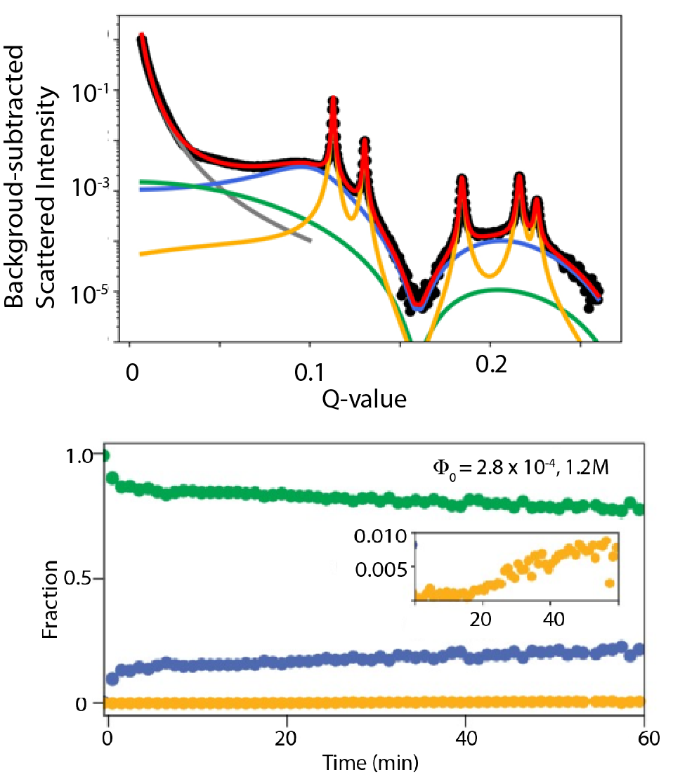
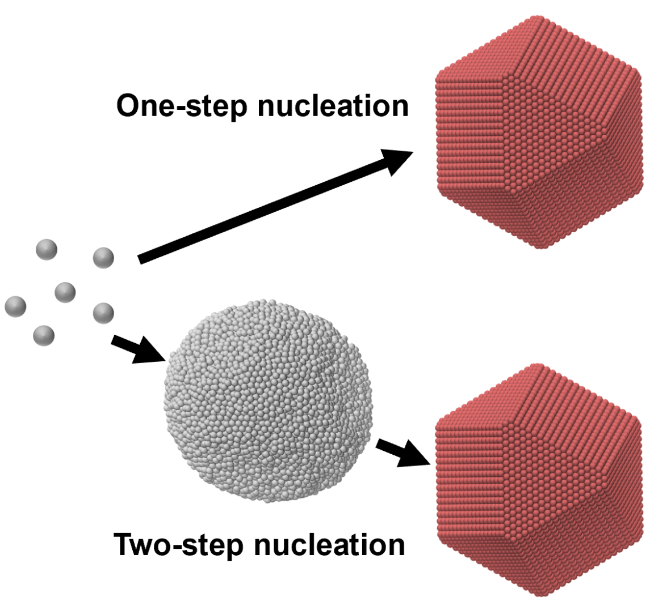
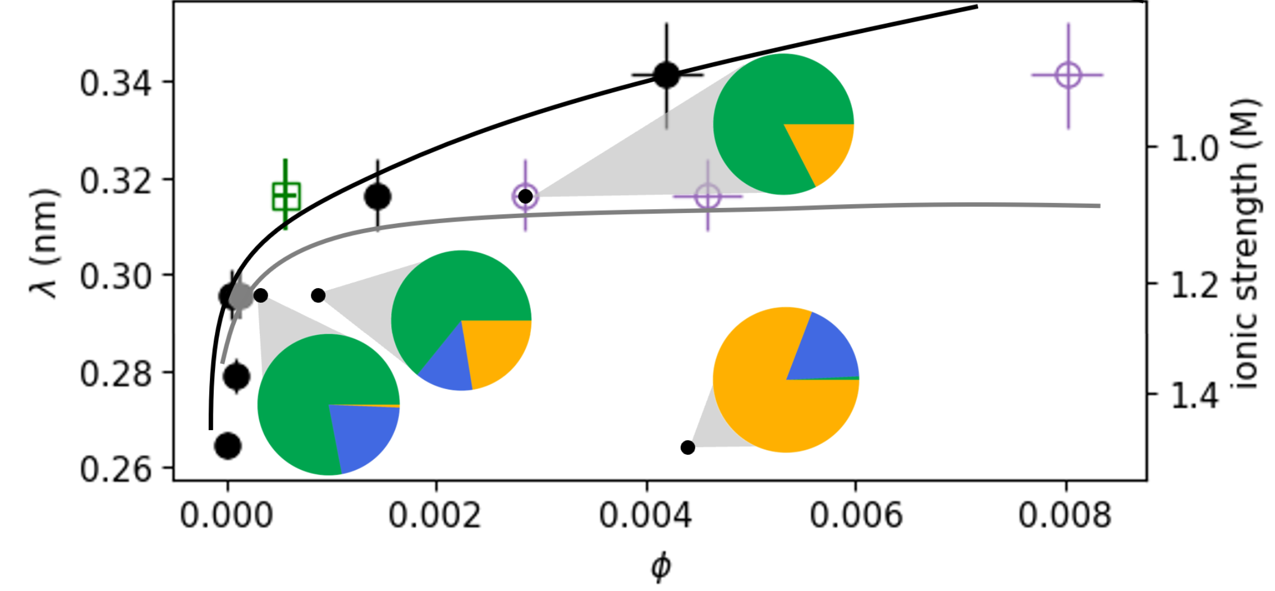








Building Materials from the Nanocrystal Up
Scientific Achievement
Researchers clarified the mechanism—an unusual intermediate state—that accelerates the transformation of nanocrystals into a superlattice with fewer defects using a two-step, instead of a one-step, process.
Significance and Impact
The new approach, which can control the development of materials with desired characteristics, could be applied to electronics, energy storage, and even medicine.
Research Details
  SAXS data from the Advanced Light Source and the Stanford Synchrotron Radiation Lightsource were fit to model the time-dependent evolution of three phases—colloidal dispersions, metastable liquid intermediates, and emerging superlattice.
  The self-assembly process was tuned by injecting salt solutions of different concentration into the nanocrystal suspensions.
Top: SAXS data decomposed into three nanocrystal phases—colloidal (green), liquid (blue), and superlattice (yellow)—and the quantitative fit (red) of the data (black).
Bottom: Fraction of nanocrystals detected by SAXS to be in each of the three phases over time at a particular quench depth and ionic strength.
C.P.N. Tanner, V.R.K. Wall, J. Portner, A. Jeong, et al., Nat. Phys, 21, 1594–1602 (2025), doi: 10.1038/s41567-025-02996-5.
Work was performed at ALS and SSRL.
Notes:
In nature, atoms align and form organized, repeating, three-dimensional solid structures called lattices. Researchers have long sought to mimic this process in the lab with nanocrystal building blocks that are larger and more varied than atoms to create new superlattice materials with desirable characteristics. These new materials could be used in electronics, energy storage, and even medicine.
Traditional techniques favor a one-step crystallization process using a colloidal phase that forces particles into the superlattice by increasing their density. A two-step pathway, however, has been shown to increase the rate of crystallization even as the process is driven harder, but the underlying mechanism behind this approach remains unclear.
A multi-institutional team of researchers led by UC Berkeley collaborated with scientists from the ALS at Lawrence Berkeley National Laboratory (Berkeley Lab) to reveal the details of the pathways to efficiently assemble a superlattice of nanocrystals that is more effective at conducting electricity.
In the study, the researchers used electrostatics to form complex building blocks that self-assemble through a two-step crystallization process into a superlattice with fewer defects than through a one-step process. The team conducted small-angle x-ray scattering (SAXS) experiments using an anoxic, gas-tight reactor at Berkeley Lab’s Beamline 7.3.3 at the ALS. This setup enabled in situ, real-time tracking of scattering patterns as nanocrystal suspensions transformed into superlattices.
Funding: US Department of Energy (DOE), Office of Science, Basic Energy Sciences (BES), Materials Sciences and Engineering Division; University of Chicago Materials Research Science and Engineering Center, supported by the National Science Foundation (NSF); NSF Graduate Research Fellowship program; National Defense Science and Engineering Graduate Fellowship program, Arnold and Mabel Beckman Foundation; Kavli Energy NanoScience Institute; Kwanjeong Educational Foundation; Alfred P. Sloan Research Fellowship, the David and Lucile Packard Foundation Fellowships for Science and Engineering; and Camille and Henry Dreyfus Teacher-Scholar Awards. Operations of the ALS and the Stanford Synchrotron Radiation Lightsource at SLAC National Accelerator Laboratory are supported by DOE BES.
Researchers: C.P.N. Tanner, V.R.K. Wall, A. Das, J.K. Utterback, L.M. Hamerlynck, J.G. Raybin, R.B. Wai, J.A. Tan, M. Gababa, and D.T. Limmer (University of California, Berkeley); J. Portner and A. Jeong (University of Chicago); M.J. Hurley, N. Leonard, and S.W. Teitelbaum (Arizona State University); C. Zhu, E. Schaible (ALS); C.J. Tassone (Stanford Synchrotron Radiation Lightsource, SLAC National Accelerator Laboratory); D.V. Talapin (University of Chicago and Argonne National Laboratory); and Naomi S. Ginsberg (University of California, Berkeley, Berkeley Lab, and STROBE)
URL: https://als.lbl.gov/building-materials-from-the-nanocrystal-up/

