Slide 1
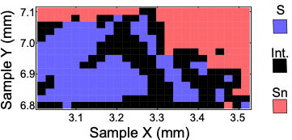


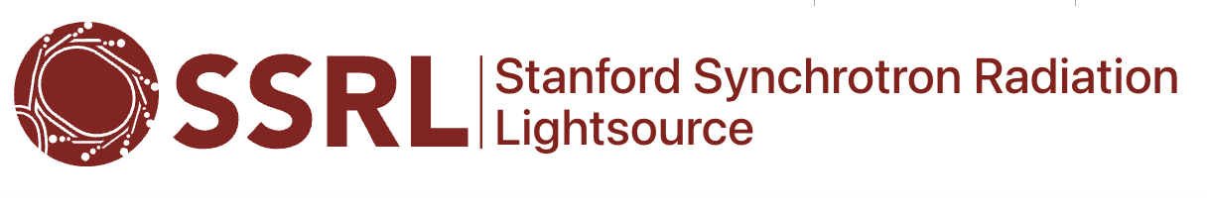



Local Disorder Impacts a Quantum Material’s Electronic States
Scientific Achievement
Machine learning tools enabled the identification of defect-rich regions in single-crystalline Co₃Sn₂S₂ that link to how surface electrons move.
Significance and Impact
Atom-level understanding of how the surface electronic properties of a magnetic semimetal can be tuned could guide its use in advanced technologies like spintronics and catalysis.
Research Details
  XPS and ARPES at the Advanced Light Source (ALS) revealed signatures of a previously unknown “intermediate” surface chemistry characterized by nanoscale defects instead of crystalline S and Sn termination.
  ML tools linked the newly discovered regions to unique surface electronic states in the topological material.
  The ALS Upgrade could improve understanding of the surface’s mesoscale structure through ARPES data with higher spatial resolution.
ARPES data show visible differences in surface electrons that occur with slight chemistry variations (crystals terminating in Sn vs S atoms)
In a spatial map of XPS data for a Co₃Sn₂S₂ sample, spectral regions grouped into 3 types reveal an intermediate surface chemistry distinct from Sn- and S-termination crystals.
S.A. Sreedhar, M. Staab, M. Chen, et al., Physical Review B 112 (24), 245154 (2025).
Work was performed at ALS/LBNL and SSRL/SLAC.
Notes:
Topological materials exhibit different electronic behaviors in their bulk and on their surface. These differences can enable new functionality, for example in spintronics and catalysis. To discover how to harness this functionality, researchers are developing quantitative frameworks to connect surface chemistry to surface electronic structure in model system such as Co₃Sn₂S₂.
In this study, researchers led by Inna Vishik, UC Davis, along with ALS Senior Scientist Eli Rotenberg and Staff Scientist Chris Jozwiak, set out to reveal systematically how surface atoms influence electronic band structures in Co₃Sn₂S₂. Spatial maps of XPS measurements revealed a surprise.
Instead of just regions defined by known spectroscopic features distinct to S and Sn termination, they showed another intermediate region rich with nanoscale defects. Correlating these maps with ARPES data confirmed that the newly-discovered region could not be described by linear combinations of the pure S-/Sn-terminations. Rather, the features indicated truly disordered atoms. The results show how local disorder can manipulate electronic surface states in a topological material.
Researchers: Mingkun Chen, Robert Prater, Zihao Shen, Valentin Taufour, Sergey Y. Savrasov, Inna M. Vishik (UC Davis)
Sudheer Anand Sreedhar, Matthew Staab (UC Davis PhD graduates and former ALS postdoctoral fellows)
Giuseppina Conti, Eli Rotenberg, Aaron Bostwick, Chris Jozwiak (ALS),
Slavomir Nemsak (ALS and UC Davis)
Hadas Soifer, Ittai Sidilkover (Tel Aviv University)
Zhenghong Wu (Carnegie Mellon University)
Vsevolod Ivanov (Virginia Tech)
Acknowledgement from paper: Use of the Stanford Synchrotron Radiation Lightsource, SLAC National Accelerator Laboratory, is supported by the U.S. Department of Energy, Office of Science, Office of Basic Energy Sciences under Contract No. DE-AC02-76SF00515. This research used resources of the Advanced Light Source, a U.S. Department of Energy Office of Science User Facility under Contract No. DE-AC02-05CH11231.
Full highlight:

