Slide 1
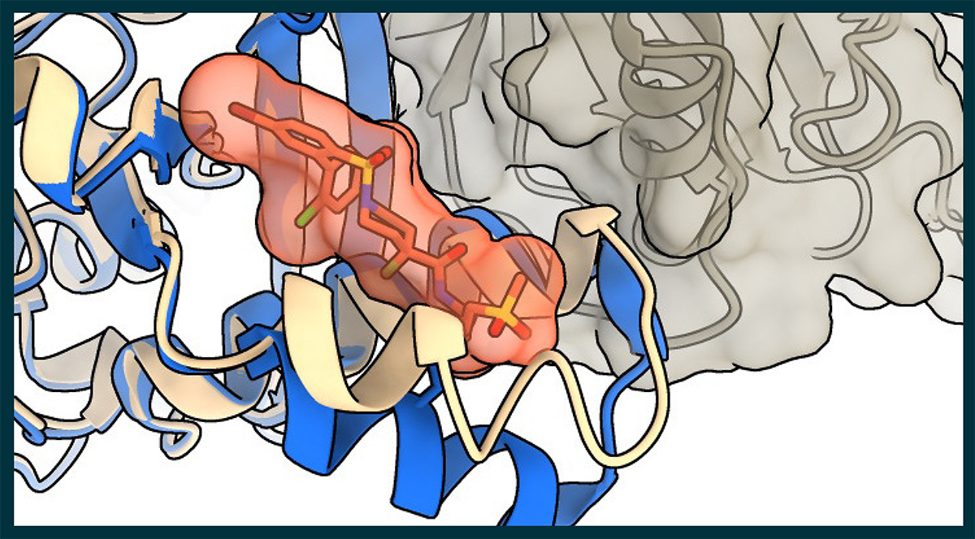


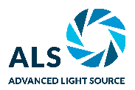

Disrupting Cancer's Broken Molecular Switch
Scientific Achievement
Researchers identified a compound that disrupts a hard-to-target tumor growth pathway in breast, lung, and other cancers and characterized the chemical interactions critical to its potency.
Significance and Impact
This work contributed to the development of a similar compound currently undergoing clinical trials in cancer patients, and informs hypotheses for designing better drug candidates.
Research Details
Researchers identified inhibitors that selectively bind to the RAS-binding region of PI3Kα, blocking activation of this key cancer growth pathway.
X-ray crystallography at the Advanced Light Source resolved molecular details of how the inhibitors disrupt the RAS–PI3Kα interaction.
Inhibitors curbed tumor growth in laboratory cancer models without causing high blood sugar side effects.
Schematic x-ray crystal structure of a newly identified compound (red-orange) bound to the RAS-binding domain of the PI3Kα protein (blue), selectively disrupting the PI3Kα-RAS interaction (Credit: Steffen Bernard/Vividion Therapeutics).
J.E. Klebba et al., “Covalent inhibitors of the PI3Kα RAS binding domain impair tumor growth driven by RAS and HER2," Science 390, 702 (2025), doi:10.1126/science.adv2684.
Work was performed at ALS/LBNL.
Notes:
RAS genes are a family of genes involved in regulating cell growth and division. Mutations in these genes drive over 22% of all human cancers by acting like broken molecular switches stuck in the “on” position, constantly activating multiple downstream signaling pathways that trigger uncontrolled cell proliferation. Treating these aggressive cancers requires a multipronged therapeutic approach that targets several RAS-activated signaling pathways. While phosphoinositide 3-kinase alpha (PI3Kα) is one of these key pathways, PI3Kα also interacts with insulin to control sugar levels. As a result, cancer patients treated with currently available PI3Kα inhibitors often experience debilitating high blood glucose symptoms, reducing their ability to take effective doses of the medicine for long periods.
While existing PI3Kα inhibitors affect the more general activity of PI3Kα, targeting the protein–protein interaction between RAS and PI3Kα appears to selectively disrupt cancer-related signaling while leaving normal cellular activities unscathed. Researchers at San Diego–based biotechnology company Vividion Therapeutics recognized this as a potential opportunity. They identified a group of candidate compounds that bind stably and selectively to the RAS-binding region of PI3Kα and characterized how the new molecules interact with PI3Kα using x-ray diffraction studies at the ALS.
The new inhibitors block tumor growth in a wide range of cancer models without disrupting normal cellular activities. This safety profile indicates a strong potential for the strategy to be used in combination with other therapies targeting the RAS pathway. Long term, this strategy could provide meaningful therapeutic benefit to an underserved patient population, fighting tumors without decreasing their quality of life.
Researchers: J.E. Klebba, N. Roy, S.M. Bernard, S. Grabow, M.A. Hoffman, H. Miao, J. Tamiya, J. Wang, C. Berry, A. Esparza-Oros, R. Lin, Y. Liu, M. Pariollaud, H. Parker, I. Mochalkin, A.N. Snead, E.J. Walton, T.E. Wyrick, E. Aitichson, K. Bedke, B.D. Horning, K.N. Lamb, W. Lin, J. Lu, M.K. Pastuszka, J. Pollock, J.J. Sigler, C. Yue, B.N. Cook, G.M. Simon, D.S. Weinstein, and M.P. Patricelli (Vividion Therapeutics); S. Rana, M. Ismail, M. Tomaschko, M. Molina-Arcas, and J. Downward (Francis Crick Institute); J.C. Brannon (Odyssey Therapeutics); J.M. Chick and T.M. Kinsella (Independent researchers); K. Hee (SciexScie); and E. Tran (Novartis Institutes for Biomedical Research).
Acknowledgment from paper: Cancer Research UK, UK Medical Research Council, Wellcome Trust, European Research Council Advanced Grant RASImmune, Howard Hughes Medical Institute, National Institutes of Health (National Institute of General Medical Sciences). Operation of the ALS is supported by the US Department of Energy, Office of Science, Basic Energy Sciences program (DOE BES).
Full highlight: https://als.lbl.gov/disrupting-cancers-broken-molecular-switch/

