Slide 1
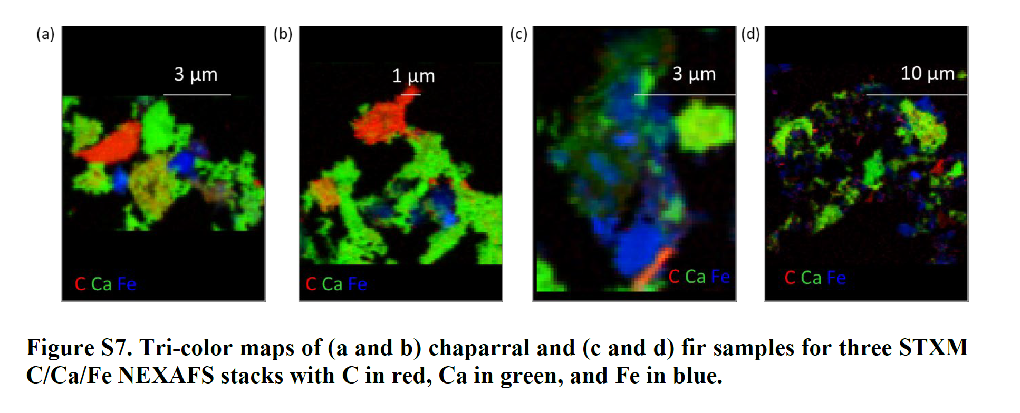




How Wildfires Transform Soil Chemistry
Scientific Achievement
Microscale changes in the elemental distribution and chemical speciation of wildfire ash were revealed using synchrotron-based x-ray techniques.
Significance and Impact
These findings shed light on how wildfires drive transient mineral formation that impacts micronutrient cycling and soil resilience, with implications for landscape recovery strategies.
Research Details
Microscopy (STXM) at ALS Beamline 5.3.2.2 mapped the internal chemistry of ash particles from 2020 Glass Fire in Northern California.
Spectroscopy (XANES) at SSRL Beamline 4-1 identified stable Fe and Mn compounds in the ash that were not present in unburned soils, and were absent from burned surface soils two years later.
STXM maps of the inside of wildfire ash show spatial relationships among carbon (red), calcium (green), and iron (blue) that were critical for interpreting experiments, revealing new minerals in ash compared to unburned soil samples.
K. Kang, E. Whelan, S. Bone, M. Rowley, M. Marcus, and J. Peña, Environ. Sci. Technol. 59, 27342 (2025), doi:10.1021/acs.est.5c07438. Work was performed at ALS/LBNL and SSRL/SLAC.
Notes:
Wildfires are becoming more frequent and severe across the globe, especially in the western United States. Not only do they burn vegetation, but they also change the chemistry of the soil in unknown ways. Researchers are examining individual ash and soil particles to learn which minerals form during a fire and how they influence nutrient mobility and ecosystem recovery later. In this study, UC Davis and Berkeley Lab Environmental Science Area scientists from the Belowground Biogeochemistry team collaborated with ALS scientists to examine the chemical structure of ash collected three weeks after the 2020 Glass Fire in Northern California and soil samples collected two years later. The samples represent different stages of post-fire soil evolution, allowing the researchers to probe how pyrogenic minerals evolve.
Surprisingly, the new minerals produced during wildfire were conspicuously absent in soil samples collected two years post-fire. Their loss from the soil surface may be due to erosion or chemical weathering, the researchers proposed. This increased mobility—likely a response to compounds exuded by microbes and roots—could facilitate soil and vegetation recovery.
Researchers: K. Kang (ALS, UC Davis, and University of Minnesota); E.M. Whelan (UC Davis); S. Bone (SSRL and Forschungszentrum Jülich); M.C. Rowley (UC Davis, Berkeley Lab, and University of Zurich); M.A. Marcus (ALS); and J. Peña (UC Davis and Berkeley Lab).
Acknowledgment from the paper: University of California, Davis; US Geological Survey; US Department of Energy, Office of Science, Biological and Environmental Research program; and Laboratory Directed Research and Development Program of Lawrence Berkeley National Laboratory. Operations of the ALS and SSRL are supported by the DOE Basic Energy Sciences program.
Full highlight: https://als.lbl.gov/how-wildfires-transform-soil-chemistry/

