Slide 1
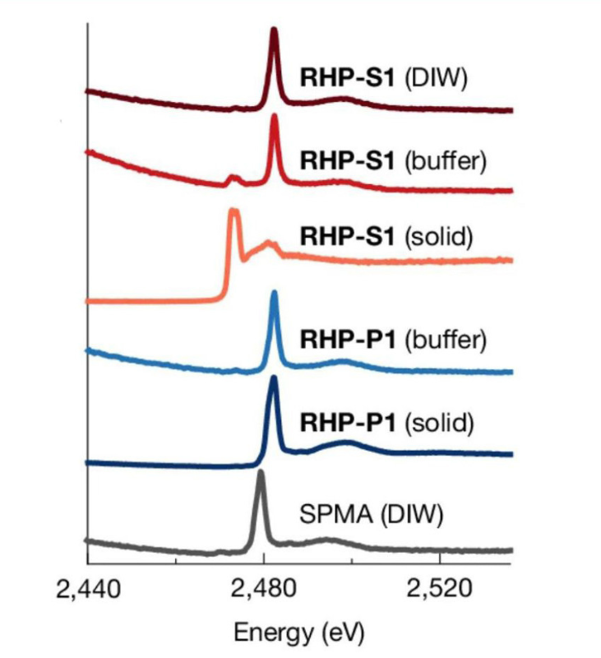








A New Framework for Designing Synthetic Enzymes
Scientific Achievement
Researchers engineered protein-like polymers that replicate complex enzyme functions.
Significance and Impact
This work offers a cost-effective, scalable approach that paves the way for functional materials in biomedicine, energy, and manufacturing.
Research Details
Bioinformatics segments and machine learning were used to determine critical sequences and synthesize polymers in a simple, efficient reaction.
X-ray techniques at the ALS revealed global folding behaviors and local microenvironments key to the catalytic activity of the polymers.
Neutron scattering showed dynamics of how polymers rearranged projected chemical groups in the presence of a target binding compound.
XANES data from Beamline 10.3.2 revealed the local microenvironment of the designed polymers’ (RHP-S1 and –P1) pseudo active sites, including water-repelling behaviors. Plot shows sulfur absorption energy, reflecting how a key catalytic region interacted with water. (Credit: Ting Xu/UC Berkeley/LBNL).
H. Yu, M. Eres, S.L. Hilburg, P. Kang, T. Jin, A. Grigoropoulos, Z. Li, D.M. Loh, I. Jayapurna, Z. Ruan, W. Fu, F. Yang, P. Ganesh, K. Toste, S. Li, J. Guo, H. Huang, F.D. Toste, R.D. Britt, Y.Z., A. Alexander-Katz, and T. Xu, “Random heteropolymers as enzyme mimics,” Nature 649, 83 (2026), doi:10.1038/s41586-025-09860-9. Work was performed at ALS and Molecular Foundry/LBNL; HFIR and SNS/ORNL.
Notes:
Many industries already use enzymes, which are specialized protein molecules that accelerate chemical reactions without being consumed. Incorporating these catalytically active molecules into materials could unleash impactful applications biomedicine, energy generation, and chemical synthesis—including masks that eliminate airborne toxicants or environmental filters that degrade pollutants. Their practicality, however, is limited: naturally occurring enzymes tend to be fragile, costly, and unstable. It's also been difficult to produce synthetic enzyme analogs on an industrial scale. In this study, researchers reinterpreted protein’s sequence-structure-function relationship to engineer polymers with complex biological functions and practical adjustments to their molecular chemistry. The researchers leveraged bioinformatics and machine learning to parse out segments critical to enzyme function and segments that might be less important to precisely control. Releasing the need to perfectly control entire sequences, along with using carbon-carbon backbones (instead of the amide backbones of naturally occurring proteins), allowed the researchers to synthesize their protein-like polymers in a simple, efficient, one-pot chemical reaction.
The resulting polymers did not form secondary structures but instead adopted varying conformations based on the hydrophobic (water-repelling) properties of segments in the chain. Although the researchers were initially skeptical, this property was ultimately beneficial: the flexible polymers locally adjusted segments to form an impromptu active site, allowing them to bind intended targets and successfully recapitulate the biological effects of natural enzymes. X-ray techniques at the Advanced Light Source (ALS) revealed global folding behaviors and local microenvironments, two key factors governing catalytic activity. Neutron scattering at the High Flux Isotope Reactor (HFIR) and the Spallation Neutron Source (SNS) uncovered chemical signatures of how polymers modulated the projection and arrangement of key segments to create a functional active site for a target binding molecule. Experiments at the Molecular Foundry characterized polymer structure and composition.
Using X-ray and neutron scattering data to validate the mechanisms underlying their approach, the authors demonstrated that it is possible to achieve protein-like function using a statistical approach to sequence control. The scalability of their new framework equips the material design community with tools to develop a vast array of protein-like polymers with useful functions.
Researchers: H. Yu, M. Eres, P. Kang, A. Grigoropoulos, D.M. Loh, I. Jayapurna, Z. Ruan, K. Toste, S. Li, H. Huang, and F.D. Toste (University of California, Berkeley); S.L. Hilburg, T. Jin, P. Ganesh, and A. Alexander-Katz (Massachusetts Institute of Technology); Z. Li (University of Illinois Urbana−Champaign); W. Fu and R.D. Britt (University of California, Davis); F. Yang and J. Guo (ALS); Y. Z. (University of Illinois Urbana−Champaign and University of Michigan, Ann Arbor); and T. Xu (University of California, Berkeley and Berkeley Lab).
Acknowledgment from paper: Defense Threat Reduction Agency (DTRA); US Department of Defense, Army Research Office; National Science Foundation (NSF); Alfred P. Sloan Foundation, US Department of Energy, Office of Science, Basic Energy Sciences program (DOE BES), Chemical Sciences, Geosciences, and Biosciences Division and Materials Sciences and Engineering Division; DOE Office of Science, Biological Environmental Research program; NSF Graduate Research Fellowship Program; Chyn Duoq Shiah Memorial Fellowship; and the MIT Undergraduate Research Opportunity Program. Operation of the Pines Magnetic Resonance Center's Core NMR Facility is supported by the National Institutes of Health. Operation of the NIST Center for Neutron Research is supported by the National Institute of Standards and Technology, US Department of Commerce. Operations of the ALS, Molecular Foundry, High Flux Isotope Reactor, and Spallation Neutron Source are supported by the DOE BES.
Full highlight: https://als.lbl.gov/a-new-framework-for-designing-synthetic-enzymes/

