Slide 1
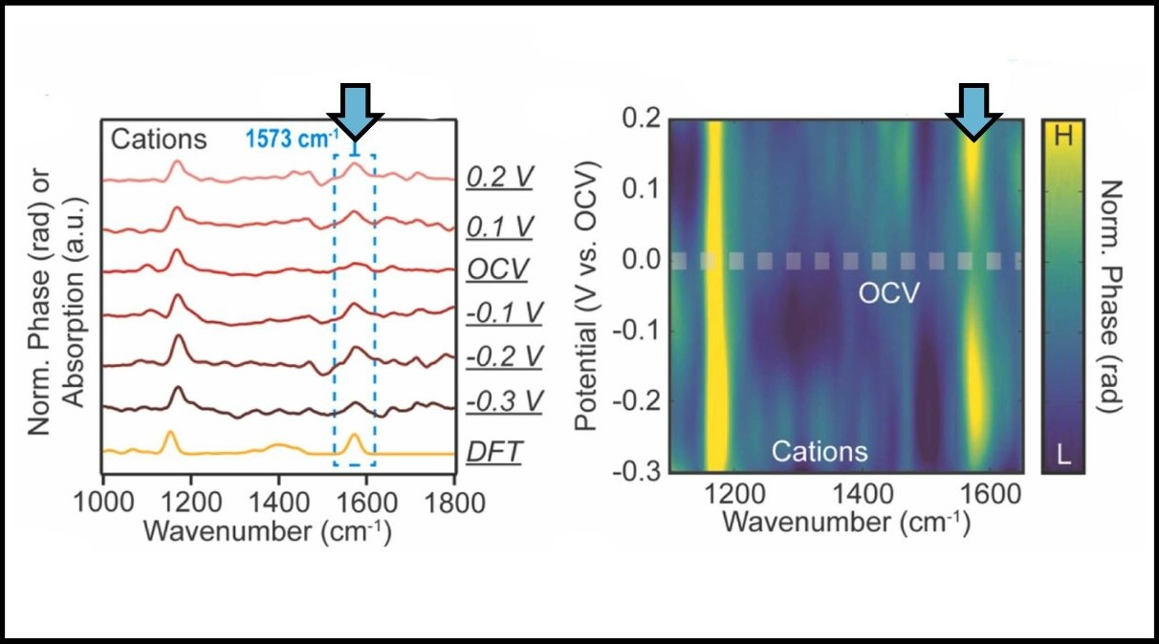





Infrared Nanospectroscopy Reveals Behaviors of Ionic Liquids
Scientific Achievement
Researchers detected molecular behaviors of ionic liquids on the nanoscale under varying charge bias conditions.
Significance and Impact
The insights inform the targeted design of high-performance ionic-liquid-based electrolytes for energy storage devices.
Research Details
First use of synchrotron infrared nanospectroscopy (SINS) to study ionic liquids uncovered molecular behaviors that correspond to key electrochemical properties.
Ions near electrode surfaces changed orientation under varying applied electrical bias conditions.
Ion size tuned the ionic liquid’s ability to form compact double layer structures, a critical property for capacitive performance.
SINS spectral data obtained at ALS Beamline 5.4 revealed cation dynamics in a sample ionic liquid at the electrode surface under varying charge bias conditions. Blue arrows highlight changes in absorption intensity in response to applied electrode bias. (Credit: Zixuan Li/Berkeley Lab)
Z. Li, K.C. Ng, S. Anderson, M. Jaugstetter, M. Salmeron, M.C. Martin, H.A. Bechtel, and S.N. Gilbert Corder, “Electrochemical dynamics of imidazolium ionic liquids at graphene electrodes for energy storage applications,” Nano Energy 151, 111785 (2026), doi:10.1016/j.nanoen.2026.111785.
Work was performed at ALS/LBNL.
Notes:
Electric double layer capacitors (EDLCs) provide a foundation for a more-resilient energy infrastructure by bridging the performance gap between conventional capacitors and rechargeable batteries. Like batteries, these supercapacitors use a chemical solution called an electrolyte to facilitate the flow of electrical charge between positively and negatively charged electrode surfaces.
Developing advanced electrolytes with optimized properties, such as improved stability under real-world operating conditions or boosted capacity, could enhance the overall performance of these systems. Ionic liquids, which are salts that exist in liquid states under ambient conditions, show promise in their performance as electrolyte components with high electrochemical stability. Still, they are not widely used commercially due to a limited understanding of how ionic liquids behave at electrode surfaces. This is in part because few techniques are capable of detecting how ionic liquids function at the nanoscale level.
In this work, researchers used infrared nanospectroscopy at the ALS to probe the orientational changes and behaviors of ionic liquids under different applied electrical bias conditions. Taken together, findings from this study elucidate how ionic liquids behave at electrode surfaces, representing a significant step towards optimizing the use of ionic liquids in functional applications. These results define a direction for larger-scale studies that could help determine which ionic liquids would be the most suitable for specific electrochemical devices, with different use cases lending specific optimization criteria.
Researchers: Z. Li (ALS and Hunter College of the City University of New York); K.C. Ng and M. Jaugstetter (Berkeley Lab); S. Anderson (University of Wisconsin, Madison); M. Salmeron (Berkeley Lab and University of California, Berkeley); and M.C. Martin, H.A. Bechtel, and S.N. Gilbert Corder (ALS).
Acknowledgment from paper: Laboratory Directed Research and Development Program of Lawrence Berkeley National Laboratory. Operation of the ALS is supported by the US Department of Energy, Office of Science, Basic Energy Sciences program (DOE BES).
Full highlight: https://als.lbl.gov/infrared-nanospectroscopy-reveals-behaviors-of-ionic-liquids/

